Slide 1



Info 5709 Data Visualization Final Project Campus Recruitment Dataset 7th August Vaishnavi Garikipati 11409444

Slide 2
Research questions and Reasons for Analysis
Data visualization is used for representing data.
The data is described in graphs, charts, and maps in the visualization tool.
These visualization tools help in understanding trends and patterns of the data processed.

Slide 3
Data Set and preprocessing
Processing big data is not understandable; thus, the visualization tool quickly helps understand the direction of the data
The data collection is done from Kaggle.com
Recruiting on campus also offers easy access to the youngest generation of talent. Coming generation is digital-native generation and is likely to have a significant impact on organizations. Campus recruitment is the best way to tap into this new generation of talent.
Here are some aspects of finding out from this dataset

Slide 4
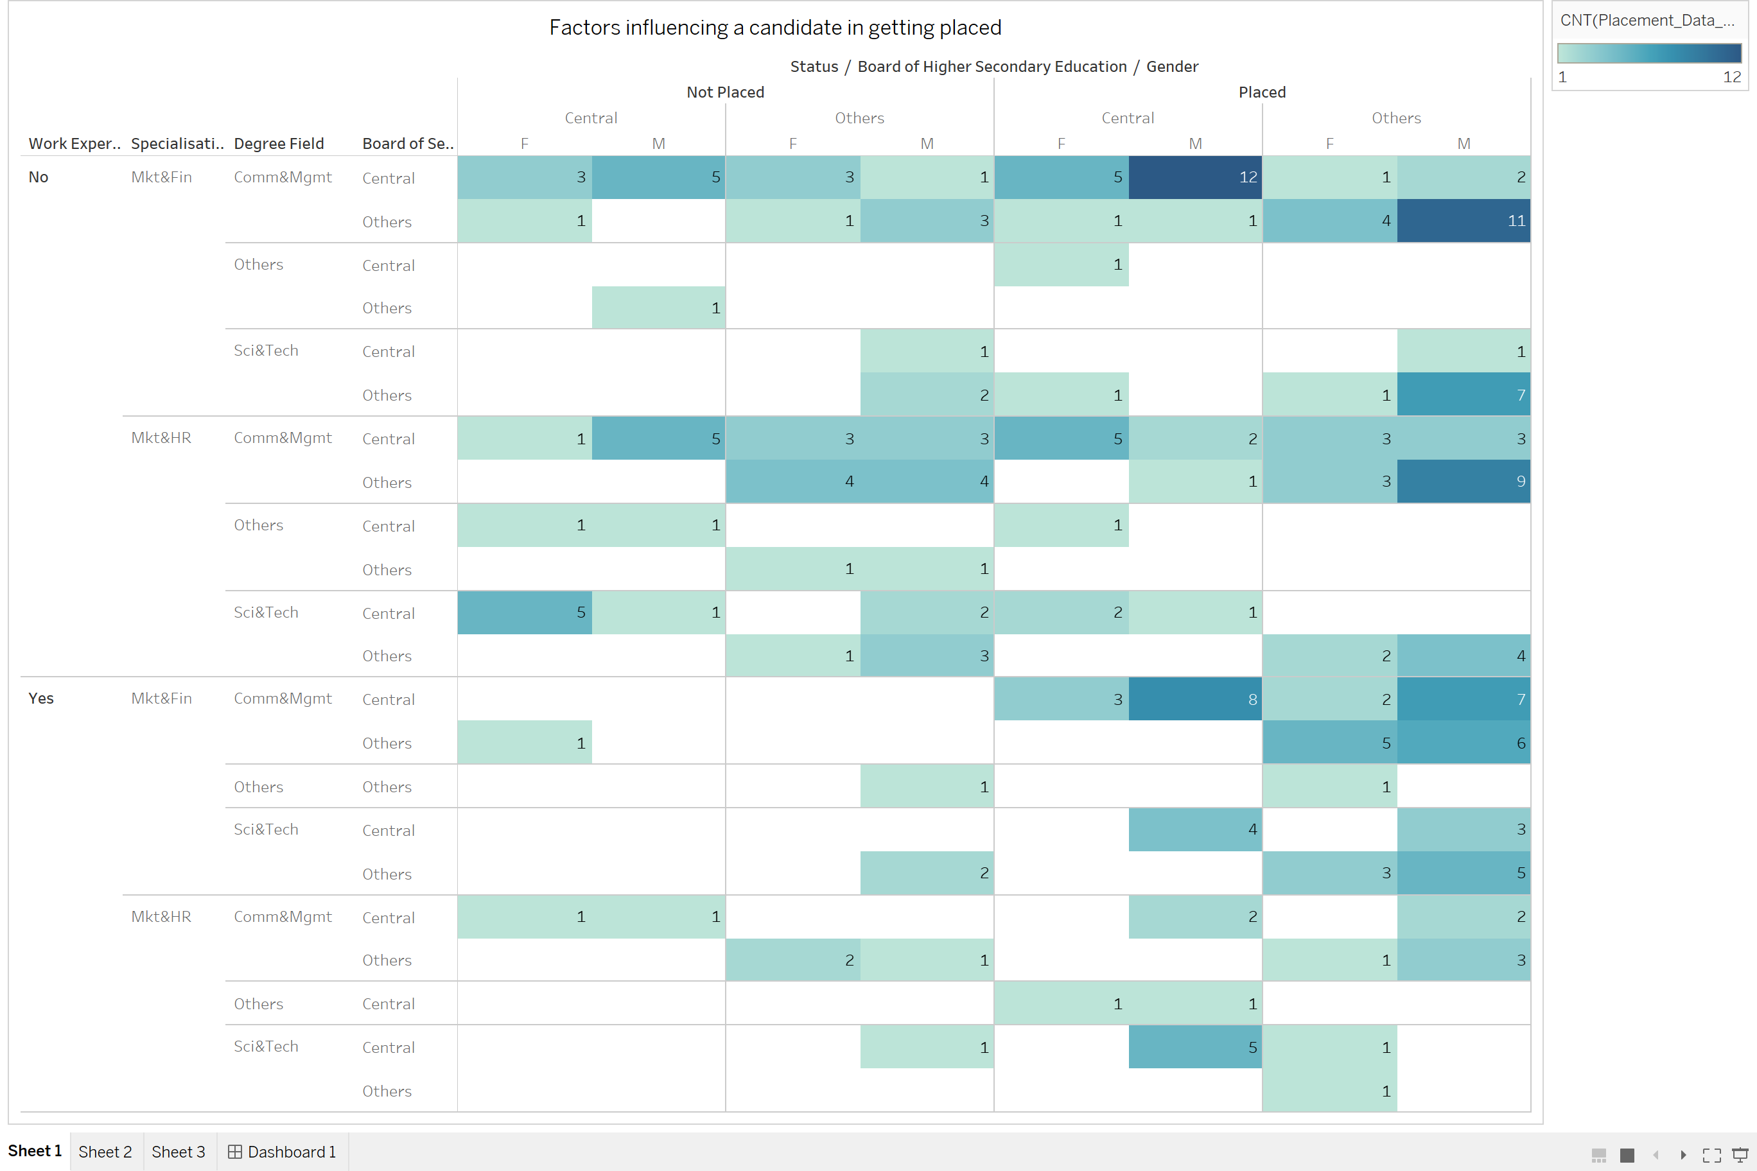
Visualization And Ideas
Which factor influenced a candidate in getting placed?
From the visualization, it can be said that the most influencing factors for placements would be
Male students
Central board during secondary and higher secondary education
Commerce & management field in degree
Marketing and finance in MBA
No experience needed/ freshers

Slide 5
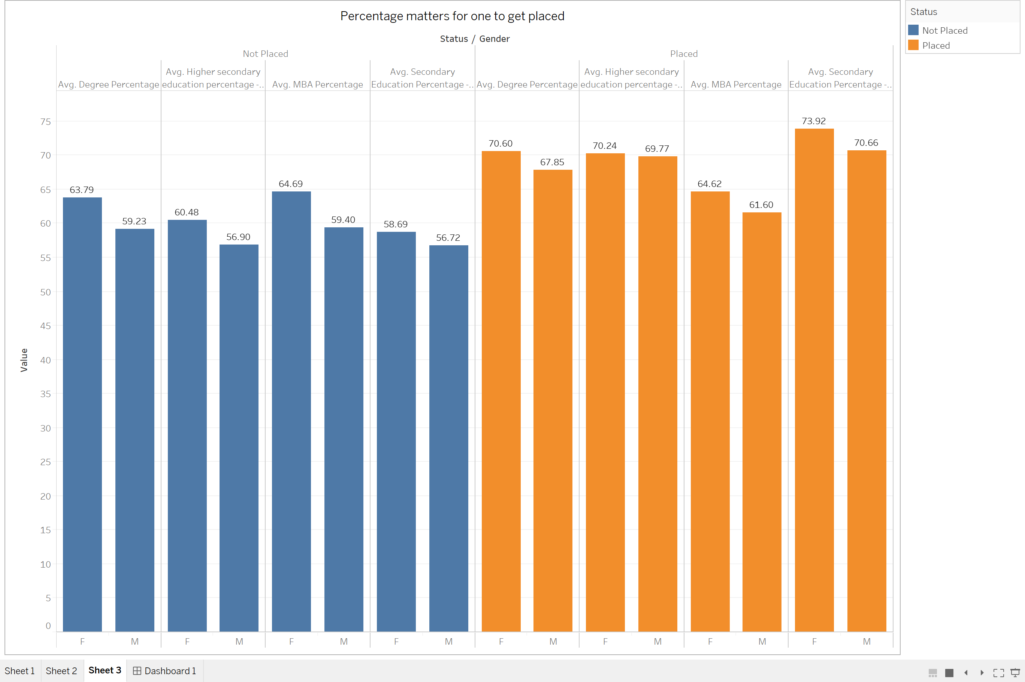
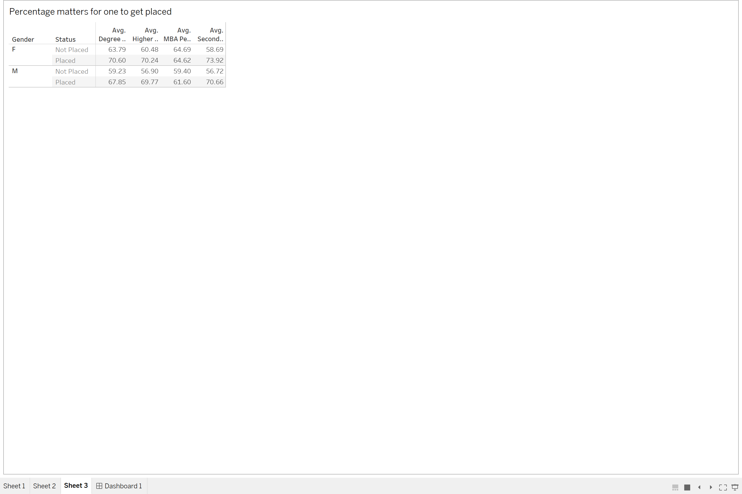
Visualization And Ideas
Does percentage matter for one to get placed?
Percentage clearly has high influence on students getting recruited. From the bar chart it can be observed that placed students have higher percentage compared to those who did not get placed.
STATS:

Slide 6
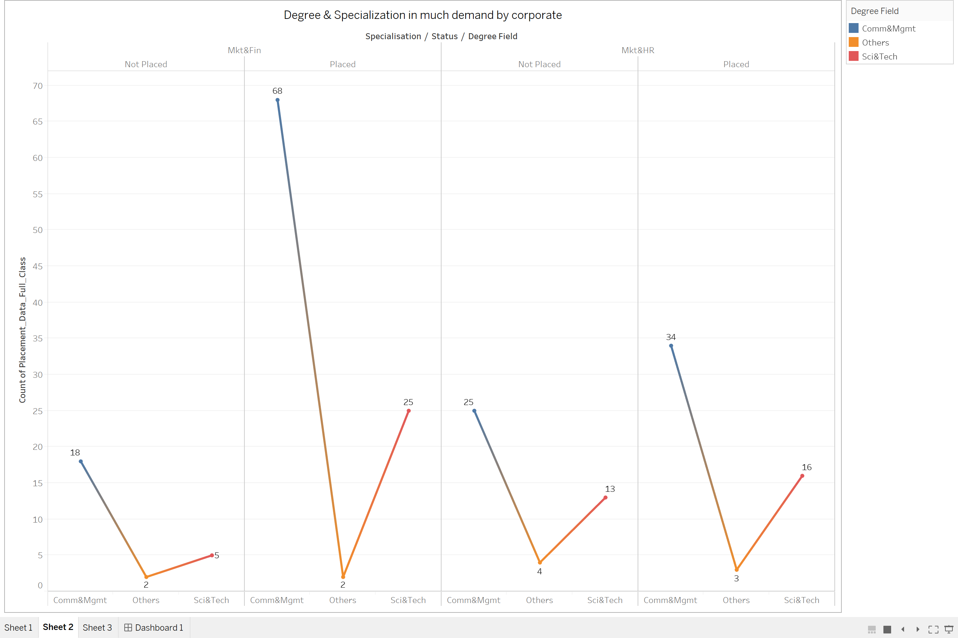
Visualization And Ideas
Which degree specialization is much demanded by corporate?
From the line graph below it can comprehended that corporate bodies are much interested in recruiting students graduated with commerce and marketing and specialized in marketing and finance. Highest number of students recruited from that combination is 68 and least is 2 from other fields of graduation.

Slide 7
Conclusion
Placements are quiet an important aspect for students whether post-graduates or graduates.
Recruits concentrate on different aspects while hiring students and by this project I have analyzed some important factors that interest recruiters by studying parameters that effect the placement rate. Visualizations are presented to strength my argument.
The dataset under consideration is dedicated only to a specific college in India and hence we cannot comprehend the results as applicable for any region but only to that college/campus.
From the analysis I came to conclusion that male students with MBA in marketing and finance with average percentage about 70% and central board during higher and secondary education have secured more campus placements.
Relatively girls from same sector of education have secured placements next to boys. Experience did not help much as freshers are recruited more than experienced students.
Science and technology students did not do well compared to management and other fields of specialization.
Therefore, students need not worry whether they have prior experience or not as long as they maintain good percentage.

Slide 8
Learning Outcomes
By Tableau visualization tool here, the trends of the recruitments are realized, and three hypotheses are established.
Data visualization is a widely used tool for the analysis of different kinds of data.
The exploratory data analysis approach is used for this analysis proces

Slide 9


THANK YOU

